Slide 1
Alternative Endings
To compare and contrast alternative endings (film and book)

Slide 2
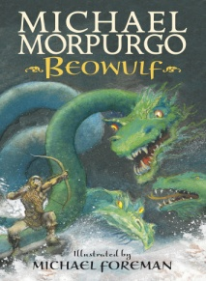
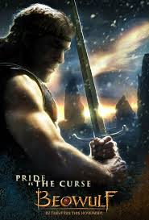
Venn diagram
Comparing and contrasting the similarities and differences between the endings of Beowulf the film version and the Michael Morpurgo book.
book
film

Slide 3
In some ways the film and book are alike.
For instance they both……………………….. Another feature they have in common is that……………………… Furthermore they are both……………… However they also differ in some ways.
For example……………..while……………. Another difference is that .....................,whereas……………….. Finally………………but…………...

Slide 4
Can you work with partner to write your own ending to Beowulf? Try to include......
Steps to Success | Included yes/no ?
We have use full stops and capital letters
We have used commas in a list or to mark clauses
We have used speech
We have varied the length of my sentences for effect
We have used imperative verbs
We have used some figurative language in my epic poem (simile, alliteration, ‘paired’ and adverbial phrases)
We have used some old English terms/words which relate to the topic
We have written in the style of an old English Epic poem
We have different sentence beginnings and some complex sentences

